Slide 1
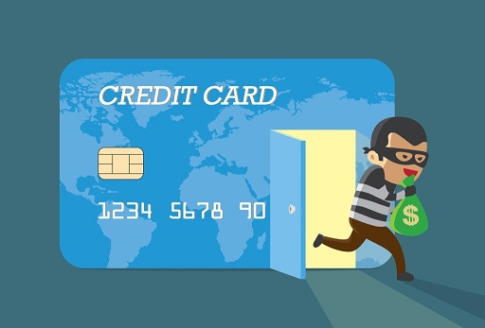
Credit Card Fraud Detection
Submitted By
Hemant Kondhalkar
Kiran Ghadigaonkar
Ria Mukherjee

Slide 2
Agenda
1
Credit Card Fraud
5
Data Understanding
9
Current Incurred Losses
2
Business Background
6
EDA
10
Business Impact
3
7
Model Building and Evaluation
11
Objective
Cost Benefit Analysis
4
Solution Methodology
8
Model selection
12
Appendix: Data Attributes

Slide 3

Credit Card Fraud
Credit card fraud is an inclusive term for fraud that is committed using a payment card, such as a credit card or a debit card, by stealing the card information through skimmers.
Skimming is a method used for duplicating information located on the magnetic stripe of the card.
Apart from this, other ways of making fraudulent transactions are as follows:
Manipulation or alteration of genuine cards
Creation of counterfeit cards
Stolen or lost credit cards
Fraudulent telemarketing
The Federal Trade Commission (US) has estimated that around 10 million people become victims of credit card theft each year. Credit card companies lose close to $50 billion per year to fraud.

Slide 4
Business Background
Finex is a leading financial service provider based out of Florida, US. It offers a wide range of products and business services to customers through different channels, ranging from in-person banking and ATMs to online banking.
In recent times, the number of fraudulent transactions increased drastically due to which, the company has been facing a lot of challenges.
For Banking companies like Finex, retaining highly profitable customers is the most important business goal. But due to the rise in digital payment channels, banking fraud, however, poses a significant threat to this goal for many banks.

Slide 5

Objective
As a consulting company hired by Finex, our job is:-
To identify the root cause of these unauthorized transactions on credit cards and recommend ways to mitigate this problem.
To create an effective system for detecting credit card fraud in order to reduce financial losses.
Significant costs result from fraudulent activities, compounded by the lack of modern financial technologies for timely detection of data breaches.

Slide 6

Solution Methodology
Build a machine learning model to predict fraudulent transactions using simulated credit transactional Kaggle data set as a proof of concept.
Understanding data features using plots and tabular aggregations
Deriving new transactional or historical features using existing features.
Understanding relations between features
Training different ML models on the data
Choosing and evaluating the best model that has the highest precision & recall
Performing Cost Benefit Analysis on the final model chosen
Data Storytelling using insights, modeling results, & Business proposal

Slide 7

Data Understanding
Credit card transactions of around 1,000 cardholders
Pool of 800 merchants
Time Period: 1 Jan 2019 to 31 Dec 2020
Total 18,52,394 transactions
Out of which 9,651 are fraudulent transactions.
Highly imbalanced, with the positive class (frauds) accounting for 0.52% of the total transactions.
The feature 'amt' represents the transaction amount.
Target Variable: The feature 'is_fraud' represents class labeling

Slide 8

Exploratory Data Analysis
Performed univariate analysis on ‘amt’, ‘city_pop’, ‘Age’, ‘Dist’, ‘Gender’.
As the kernel density function clearly shows major skewness for ‘amt’, and ‘city_pop’ variables. Hence, treated those variables with log transformations.
No major skewness was found in the ‘Dist’ and ‘Age’ variables.
The data shows a clear imbalance in the target variable ‘is_fraud’ which needs to be handled by sampling methods.

Slide 9
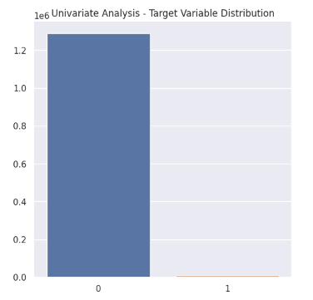
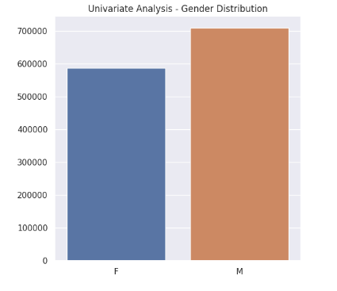
Exploratory Data Analysis

Slide 10
Model Building and Hyperparameter Tuning
To create classification models, the below order of algorithms will be used to detect fraudulent transactions:
Logistic Regression
Decision Trees
Random Forest
XGBoost
Each algorithm will have an unsampled model and then it will be compared by using sampling methods - SMOTE and ADASYN.

Slide 11
Model Evaluation
The metric used to evaluate the models – Recall
Recall attempts to answer the following question:
What proportion of actual positives was identified correctly?
The formula for recall (also known as sensitivity or true positive rate) is as follows:
Recall = True Positives (TP)/(True Positives (TP) + False Negatives (FN))
Below algorithms will have an unsampled model and then it will be compared by using sampling methods - SMOTE and ADASYN.
Logistic Regression
Decision Trees
Random Forest
XGBoost

Slide 12
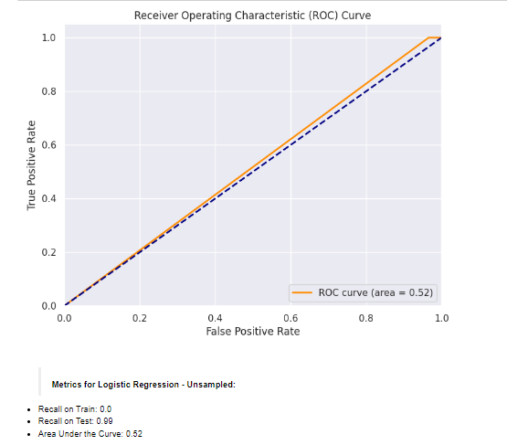
Logistic Regression - Unsampled

Slide 13
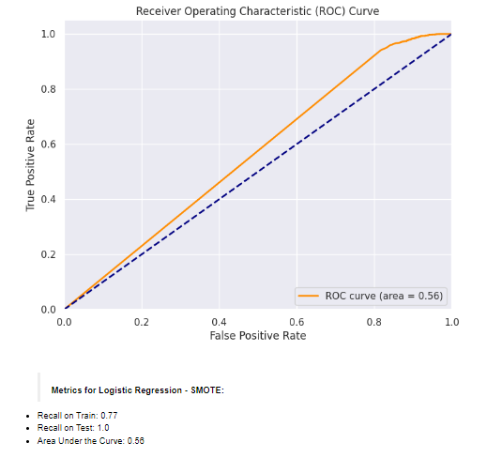
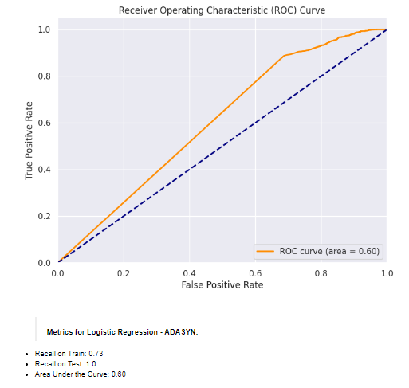
Logistic Regression – Sampled (SMOTE, ADASYN)

Slide 14
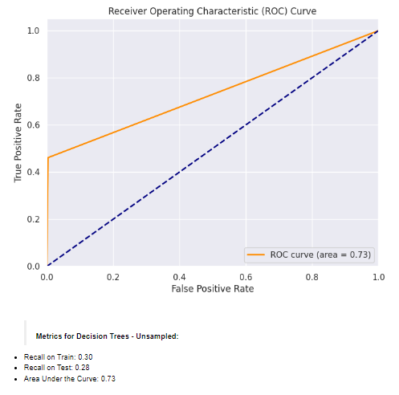
Decision Tree Classifier - Unsampled

Slide 15
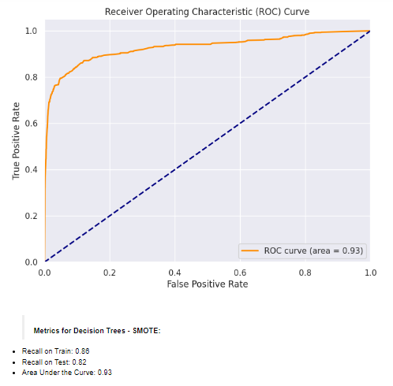
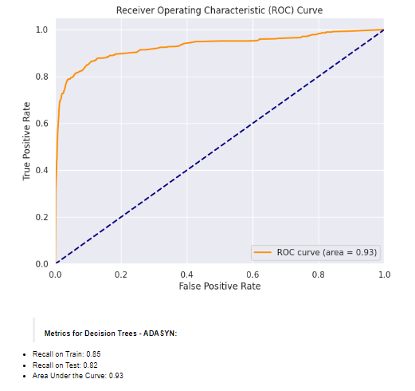
Decision Tree – Sampled (SMOTE, ADASYN)

Slide 16
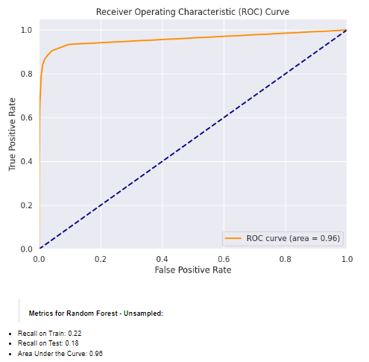
Random Forest - Unsampled

Slide 17
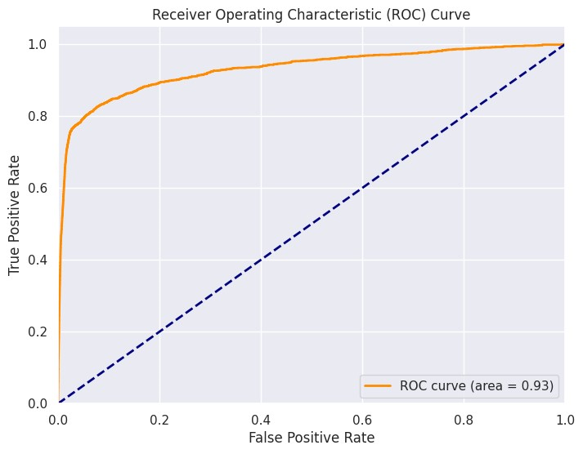
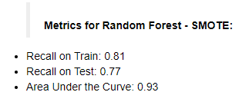
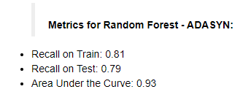
Random Forest – Sampled (SMOTE, ADASYN)

Slide 18
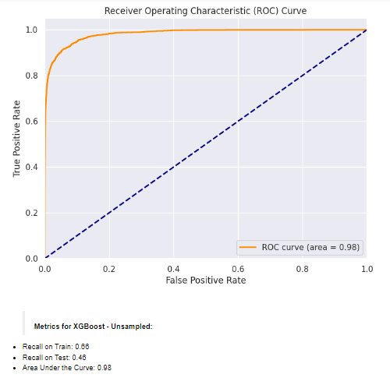
XGBoost- Unsampled

Slide 19
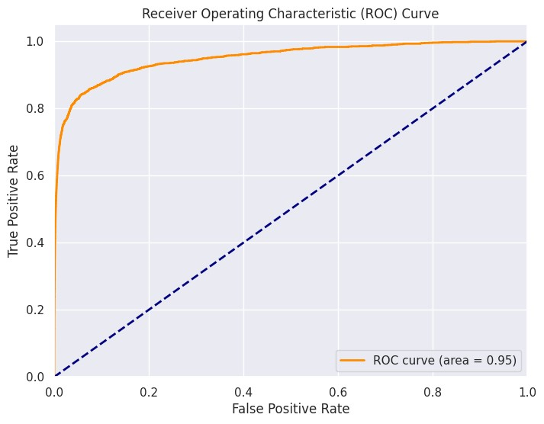
XGBoost – Sampled (SMOTE, ADASYN)
Metrics for XGBoost - SMOTE
- Recall on Train: 0.86
- Recall on Test: 0.81
- Area Under the Curve: 0.95
Metrics for XGBoost - ADASYN
- Recall on Train: 0.86
- Recall on Test: 0.81
- Area Under the Curve: 0.95

Slide 20
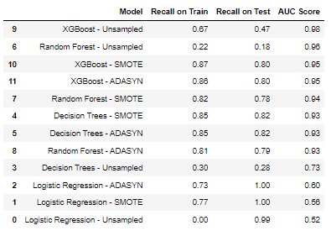
Model Selection and Model Building
summary of all values to help us pick the best model of all based on:-
Recall scores
AUC Scores
Confusion Matrices
collected from the 12 algorithms
(4 algorithms - unsampled and sampled)

Slide 21
Current Incurred Losses
Out of 77,183 credit card transactions on average every month, an average of 402 transactions are flagged as fraudulent.
Each fraudulent transaction results in an average monetary loss of $530.00.
The total amount of expenses linked to fraudulent transactions is $213,392.

Slide 22
Business Impact
The detection of 235 fraudulent transactions led to a cumulative customer support cost of $352.50.
Additionally, 70 fraudulent transactions went undetected by the model, resulting in a loss of $37,100.
The total cost after deploying the model is $37,452.50.
As a result of implementing the new model, the final savings amount is $1,75,607.00.

Slide 23
Cost-Benefit Analysis
Cost Benefit Analysis
Average number of transactions per month | 77183
Average number of fraudulent transaction per month | 402
Average amount per fraud transaction | $530.00
Cost incurred per month before the model was deployed (b*c) | $2,13,060.00
Average number of transactions per month detected as fraudulent by the model (TF) | 235
Cost of providing customer executive support per fraudulent transaction detected by the model | $1.50
Total cost of providing customer support per month for fraudulent transactions detected by the model (TF*$1.5) | $352.50
Average number of transactions per month that are fraudulent but not detected by the model (FN) | 70
Cost incurred due to fraudulent transactions left undetected by the model (FN*c) | $37,100.00
Cost incurred per month after the model is built and deployed (4+6) | $37,452.50
Final savings = Cost incurred before - Cost incurred after(1-7) | $1,75,607.00

Slide 24
Appendix: Data Attributes
index = Unique Identifier for each row
transdatetrans_time = Transaction Date Time
cc_num = Credit Card Number of Customer
merchant = Merchant Name
category = Category of Merchant
amt = Amount of Transaction
first = First Name of Credit Card Holder
last = Last Name of Credit Card Holder
gender = Gender of Credit Card Holder
street = Street Address of Credit Card Holder
city = City of Credit Card Holder
state = State of Credit Card Holder
zip = Zip of Credit Card Holder
lat = Latitude Location of Credit Card Holder
long = Longitude Location of Credit Card Holder
city_pop = Credit Card Holder’s City Population
job = Job of Credit Card Holder
dob = Date of Birth of Credit Card Holder
trans_num = Transaction Number
unix_time = UNIX Time of Transaction
merch_lat = Latitude Location of Merchant
mech_long = Longitude Location of Merchant
is_fraud = Fraud Flag -> Target Variable

Slide 25
Reference Links
Credit Card Fraud
How Credit Card Skimming Works
Dataset

Slide 26

Link For Video Presentation
https://youtu.be/fl1MG-ffmu8

Slide 27

THANK YOU

